Slide 1

(SOC501) Sociology: Theory and Methods
The Homo Oeconomicus debate
Amine Sijilmassi
amine.sijilmassi@um6p.ma

Slide 2
A typical individualist or (“agentic”) paradigm: Rational Choice Theory
One of the most popular and successful paradigm: predominant in economics, influential in political science and part of sociology.
Main idea: individuals make rational decisions by analyzing the costs and benefits of every available option.
To make rational decisions, individuals/agents use:
  the information they have — about the different options they have and their respective costs and benefits
their preferences: the relative value they ascribe to different objects (e.g., I prefer apples to pears). Most preferred options bring you more utility (= satisfaction, well-being…)

Slide 3
Rational Choice Theory
Assumptions:
Individuals are instrumentally rational: they act in a way that maximizes their satisfaction given the information and preferences they have
  Individuals' preferences are selfish: they act in a way that maximizes their own personal satisfaction, given what information and what preferences they have
Why is RCT so successful?
Allows us to build models: simplified descriptions of complex phenomena
Models allow us to make predictions (if X happens, Y will happen)
It has been highly successful in describing many social behavior (e.g., economic behavior, but also more "social" decisions like crime, education, founding a family...)

Slide 4

Workshop: RCT and its alternatives in the study of social exchange
Read Becker’s article
Discussion: based on reading Becker, Zelizer and Ostrom, what are the strength and limitations of the RCT approach to social exchange/cooperation?

Slide 5
Ok, Homo Oeconomicus is flawed, but what strategies exist to move forward?

Slide 6
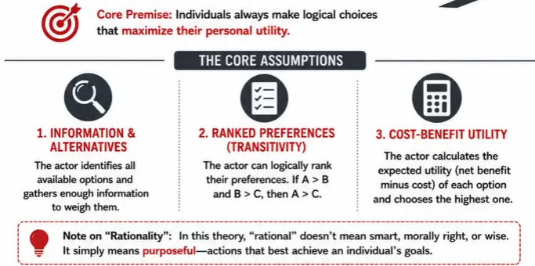
Option 1: The « embededness » literature
Criticize the Homo Oeconomicus model by showing that, in reality, economic behavior is not a decontextualized cost-benefit analysis, but is rich with social, cultural or symbolic meaning.
A caveat here: to some extent, Homo Oeconomicus actually deals with this critique through the concept of preferences…
Because RCT is agnostic about where the preferences come from: they can very well be culturally defined!
The critique becomes more interesting when more fundamental aspects of behavior

Slide 7

Historical embededness: the historical construction of markets
Modern economic markets are the result of a process of « de-embededness » (« désencastrement »): economic transactions are disconnected from their context

Slide 8

“Cultural embeddedness”: the fact that an economic operation is embedded in cultural worldviews: e.g. the differentiation of “monies” by gender (money earned by women being seen as more “frivolous”, not for serious expenses)
“Social earmarking (marquage social)”

Slide 9
Option 2: Saving RCT from itself. The case of Ostrom
The solution to the « problem of cooperation » relies on the concept of « institutions ».

Slide 10
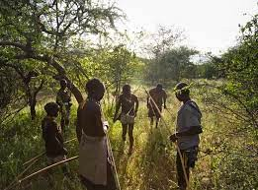
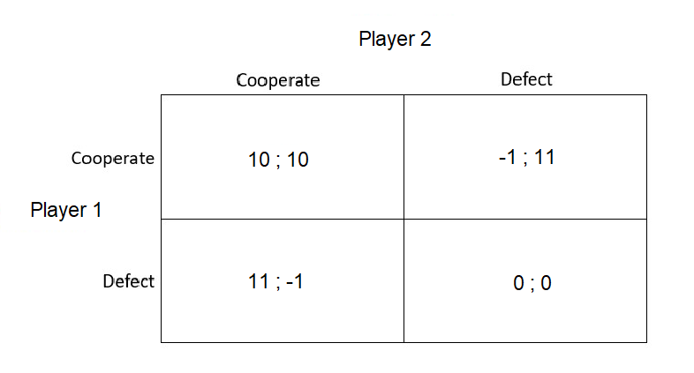
The problem so far
Cooperation is a puzzle from an RCT perspective: individuals that pay a cost for the benefit of others lose from the interaction.
This paradox is aptly modeled in the one-shot Prisoner's Dilemma:
The Nash Equilibrium is to defect!

Slide 11
The problem so far
But: cooperation can evolve under two conditions
When cooperation is among close kin (but we leave this aside, as most interesting cases of cooperation are with non-kin).
  When the PD is iterated - i.e., when people cooperate multiple times, the most adaptive strategy is
Conditional Cooperation
  Cooperation also yields reputational benefits: in biological markets where individuals choose their partners, those with a better reputation get selected more often

Slide 12
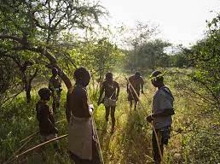
The problem so far
The human brain is naturally calibrated to spontaneously cooperate with genetically related people; when the probability of being reciprocated is high enough; or when reputational incentives are high enough.
Problem: these conditions are not always met.

Slide 13
Problem 1: Non-excludable goods
People cooperate to produce "goods" (in a very broad sense of: anything that can be consumed for one’s satisfaction)
Some goods are particularly prone to cooperation problems because temptation to cheat is very high and reciprocity/reputation cannot function well.
Excludable good = you can exclude people who have not contributed from consuming the good.
Rival good = consumption by one individual prevents consumption by another individual

Slide 14
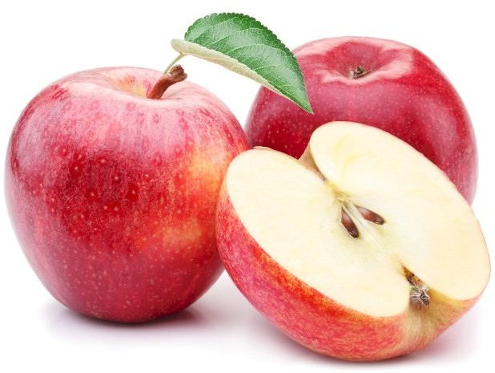
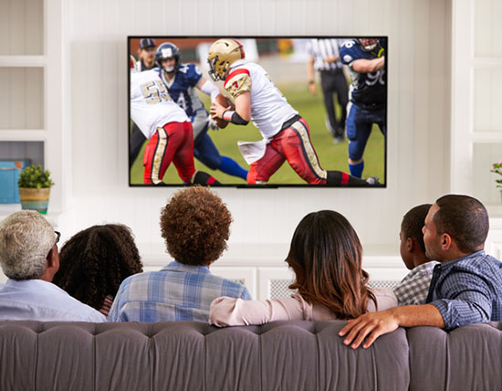
Example of a rival good: apples. When someone buys an apple from me and consumes it, it cannot be consumed by someone else
Example of a non-rival good: TV shows (it’s the same show if 1 person or 10000 people watch it)
Rival
Non-rival

Slide 15
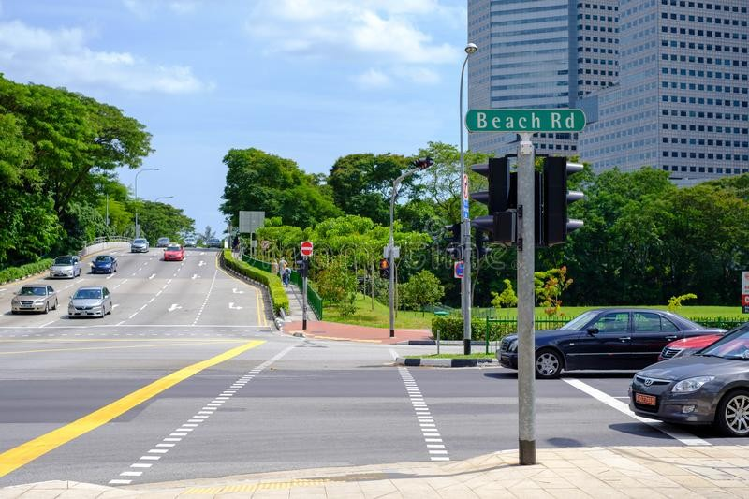

Example of a non-excludable good: a clean street. When people do the effort of not throwing garbage on the ground, those who don't will still benefit from a clean street.
Example of an excludable good: cars. Only those who have paid for it can use it. I can exclude people who haven't paid for the good from consumption.
Excludable
Non-excludable

Slide 16

Non-excludable goods are often assumed to be more prone to free-riding
Ex: lighthouse
But see: Coase, R. H. (1974). The lighthouse in economics. The journal of law and economics, 17(2), 357-376.

Slide 17
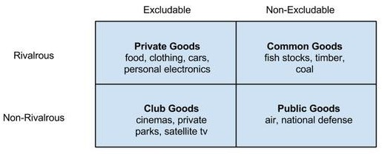

Slide 18
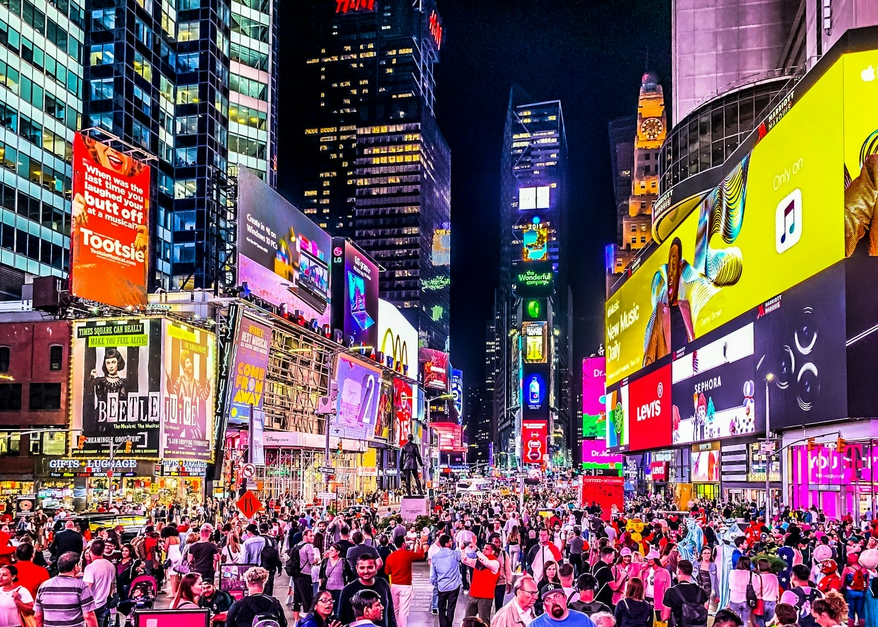
Problem 2: Anonymous cooperation

Slide 19
The problem so far
The human brain is naturally calibrated to spontaneously cooperate when the probability of being reciprocated is high enough, or when reputational incentives are high enough.
Yet, in many situations, these conditions are not satisfied, for example:
  in large groups of anonymous strangers
  when it comes to produce or preserve non-excludable goods (common goods, public goods)—for which there is a very high temptation to cheat
➡ In these cases, RCT predicts defect rather than cooperate. And yet, large-scale cooperation exists!

Slide 20




This is when institutions come into play!

Slide 21
Outline
The problem of large-scale cooperation
What is an institution
Institutions and the second-order free-rider problem
Inequality in human societies

Slide 22
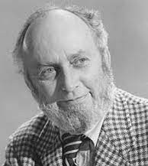
What are institutions?
Institutions = “humanly devised constraints that structure social interactions” (North, 1990)
  i.e., what humans do to change the rules of the game that structures their strategic interactions—to make cooperation pay more than defection
Examples:
➡ State
➡ Laws
➡ Religions
Douglas North (Nobel Prize in economics, 1993)
➡ Marriage systems
➡ Kinship systems, etc.
North, D. (1990). Institutions, institutional change, and economic performance.

Slide 23
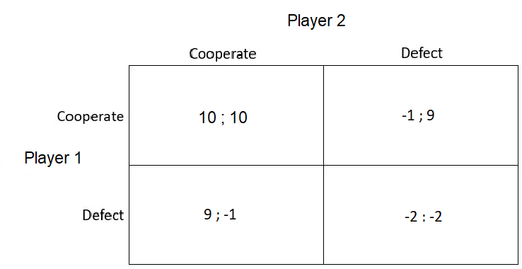
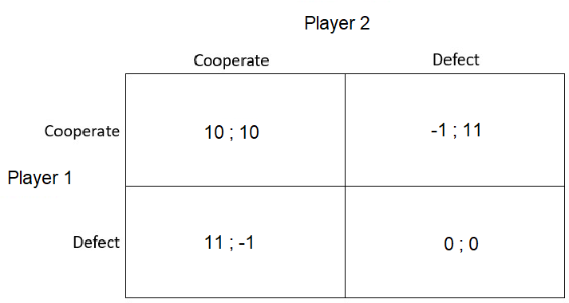
What does it mean to "change the rules of the game"?
Standard Prisoner's Dilemma
Prisoner's Dilemma with enforcement:
defection is systematically punished with -2.
See Ostrom (1990)

Slide 24
Prisoner's Dilemma with enforcement:
defection is systematically punished with —2.
If Player 2 cooperates, Player 1 is better off cooperating (10 > 9)
See Ostrom (1990)

Slide 25
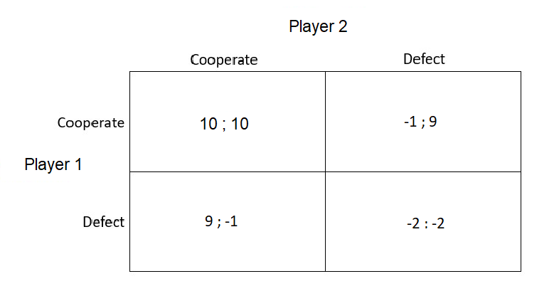
Prisoner's Dilemma with enforcement:
defection is systematically punished with —2.
If Player 2 cooperates, Player 1 is better off cooperating (10 > 9)
If Player 2 defects, Player 1 is better off cooperating (-1 > -2)
With punishment, the Nash Equilibrium is now (Cooperate; Cooperate)!
See Ostrom (1990)

Slide 26
How do humans create institutions?

Slide 27

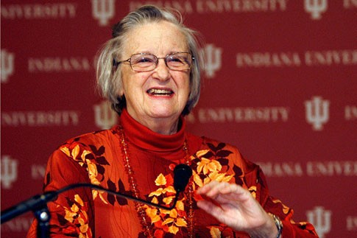
The most important person in RCT critique
Elinor Ostrom, political scientist. Winner of the Nobel Prize in Economics in 2009
Ostrom, E. (1990). Governing the commons: The evolution of institutions for collective action. The Political economy of institutions and decisions.

Slide 28
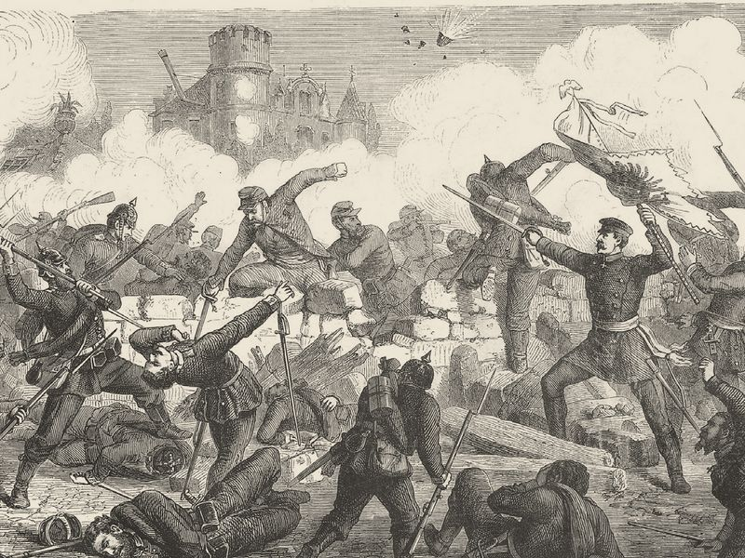

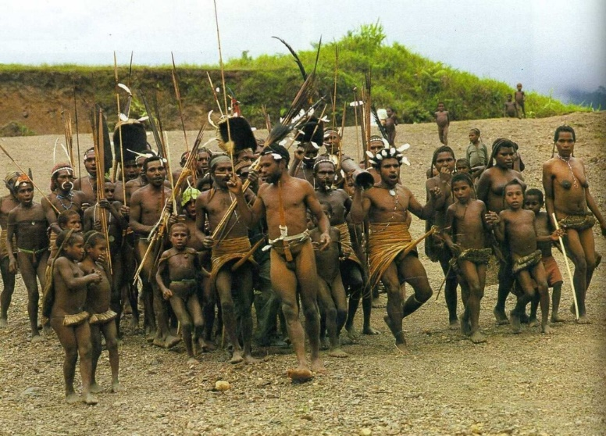
Before Ostrom…
In social sciences (and policy), institutions were often considered as something « external » to individuals

Slide 29

The « Leviathan »
A conception of the state as an external force that stabilizes cooperation through monitoring and punishment
"If ruin is to be avoided in a crowded world, people must be responsive to a coercive force outside their individual psyches, a 'Leviathan', to use Hobbes's term" (Hardin 1978, p. 314).
A conception of the state as an external force that stabilizes cooperation through monitoring and punishment

Slide 30
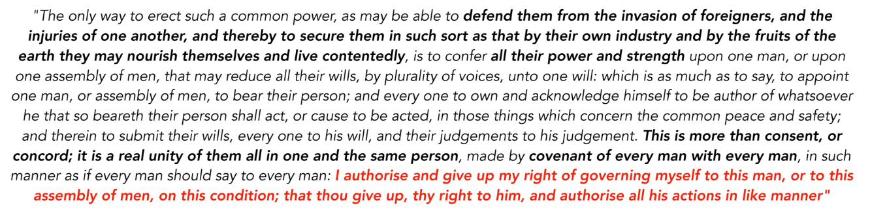
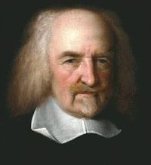
Hobbes

Slide 31
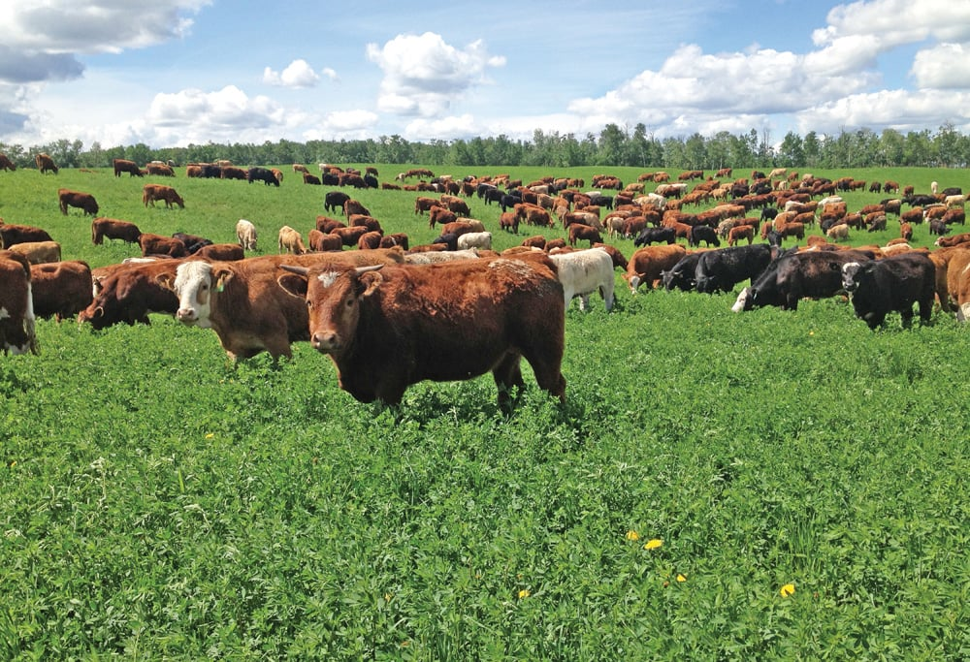
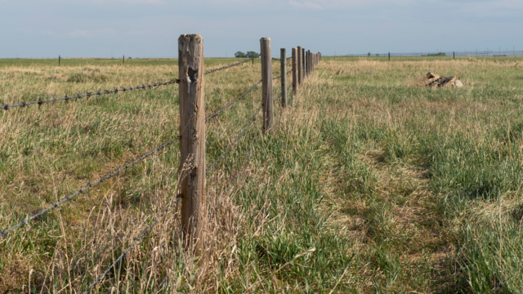
Private property
Property rights « solve » the free-rider problem because they re-introduce excludability
Open field
Property rights
You cannot exclude cheaters
You can exclude cheaters
"Now each herder will be playing a game against nature in a smaller terrain, rather than a game against another player in a larger terrain" (Ostrom, p.12).

Slide 32
Ostrom’s critique
State and private property solutions share the assumption that individuals are helpless without an external and coercive institution.
Both solutions assume that institutions will be enforced without problem: states will magically do good; property rights will magically be enforced.
Ostrom argues that individuals are very well able to self-organize and create endogenous institutions that promote cooperation.
They achieve cooperation not by spontaneous harmony but by well-designed institutions (rules, monitoring systems, justice systems, etc…)

Slide 33
Ostrom and Rational Choice Theory
Rational choice analysis is great, but it needs:
  ... to account for the possibility that people can design their own institutions
  ... to consider all the "detail" environmental variables that affect cooperation (and, in fine, the design of institutions)
Environmental parameters include:
  Are the resources unpredictable or not? (irregular rainfall...)
  Is communication easy? (long-distances, technology...)
  How difficult is monitoring? (is cheating easy to hide or obvious to everyone...)

Slide 34
How can we change the rules of the game?
➡ Punishment: increasing the immediate cost
of free-riding (e.g., fines, jail sentences, taxes)
➡ Monitoring: increasing the probability that free-riding is detected
➡ Increasing the circulation of information (e.g., making violations reputational public, so that everyone knows that you cheated)
➡ Increasing the rewards of cooperating
(e.g., subsidies)
Monitoring & punishment of free-riding
Increased cooperation
Clutton-Brock, T. H., & Parker, G. A. (1995). Punishment in animal societies. Nature.
Balliet, D., Mulder, L. B., & Van Lange, P. A. (2011). Reward, punishment, and cooperation: a meta-analysis. Psychological bulletin, 137(4), 594

Slide 35
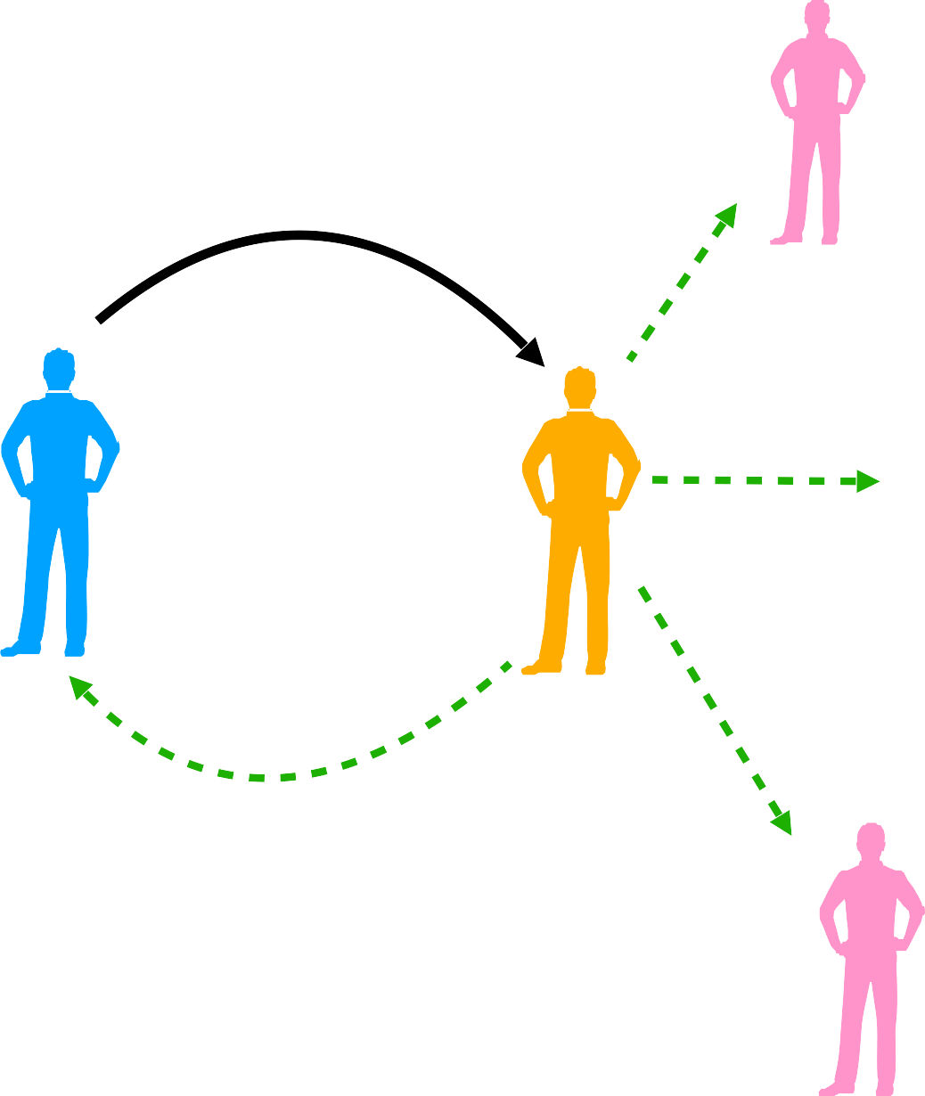
But enforcement is… a public good
Punishment is costly to the punisher, while the benefits of punishment are diffusely distributed over members of the social group
In other words: changing the rules of the game to promote cooperation is itself a costly behavior that produce non- excludable benefits!
i.e., a cooperative behavior posing a
free-riding problem...
Monitoring & punishment of free-riding
+ b
–– c
+ b
+ b
Increased cooperation
+ b
Yamagishi, T. (1986). The provision of a sanctioning system as a public good. Journal of Personality and social Psychology.
Hechter, M. (1988). Principles of group solidarity.
University of California Press.

Slide 36
The second-order free-rider problem
If monitoring & punishment produce public good benefits, then:
If others contribute to monitoring and punishment, I am better off enjoying the benefits of increased cooperation in my group without paying the cost of monitoring/punishing
If others do not contribute to monitoring and punishment, I am better off not paying the costs of monitoring & punishment (cooperation will anyway not be achieved if I police alone)
Sounds familiar?
Yamagishi, T. (1986). The provision of a sanctioning system as a public good. Journal of Personality and social Psychology.
Hechter, M. (1988). Principles of group solidarity.
University of California Press.

Slide 37
The second-order free-rider problem
The behaviors that could allow to solve the free- rider problem (e.g., monitoring & punishment) themselves raise a free-rider problem!
Yamagishi, T. (1986). The provision of a sanctioning system as a public good. Journal of Personality and social Psychology.
Hechter, M. (1988). Principles of group solidarity.
University of California Press.

Slide 38
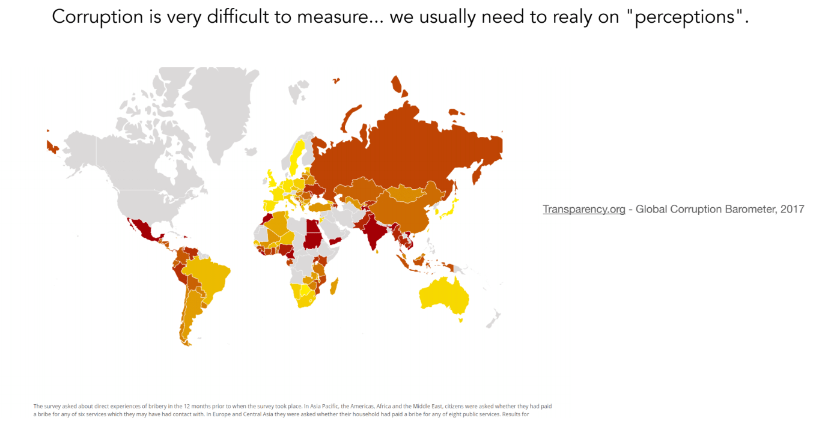

Slide 39
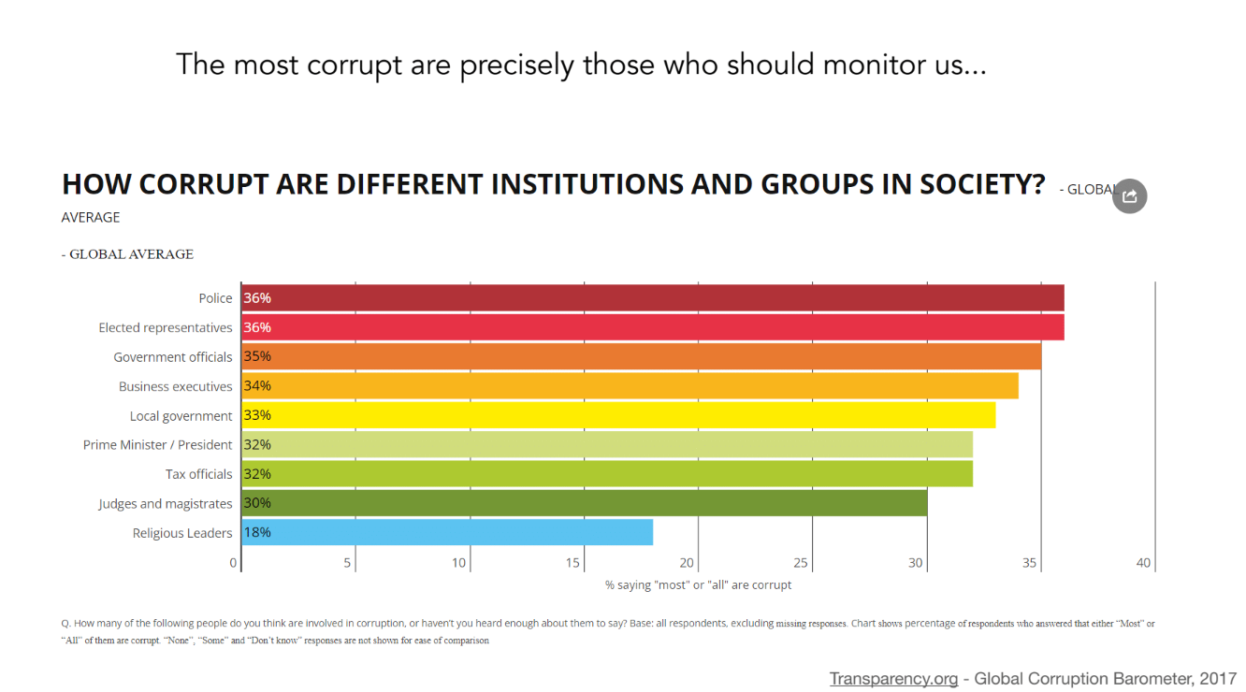

Slide 40

Self-interest, reciprocity, and reputation solve the second-order free-rider problem
Self-interest: Often, the rules that people design are such that some individuals have an immediate self-interest to monitor cheating
“Irrigation systems, for example, usually place the two actors most concerned with cheating in direct contact with one another. The irrigator who nears the end of a rotation turn would like to extend the time of his turn (and thus the amount of water obtained). The next irrigator in the rotation system waits nearby for him to finish, and would even like to start early. The presence of the first irrigator deters the second from an early start, the presence of the second irrigator deters the first from a late ending. Neither has to invest additional resources in monitoring activities. Monitoring is a by product of their own strong motivations to use their water rotation turns in the fullest extent." (p. 95).
Ostrom (1990)

Slide 41
Self-interest, reciprocity, and reputation solve the second-order free-rider problem
Reciprocity/conditional cooperation: Often, there is a division of labor in which some people are paid by the rest of the community to monitor free-riding. They are accountable to the community: if they don't do their job well, they are fired (reciprocity)
"When internal monitoring is accomplished as part of a specialized position accountable to the other appropriators, several mechanisms increase the rewards for doing a good job or exposing slackards to the risk of losing their position. In the Spanish huertas, a portion of the fines is kept by the guards; the Japanese detectives also keep the saké they collect from infractors.
All of the formal guard positions are accountable to the appropriators, and thus the monitors can be fired easily if discovered slacking off." (p. 96)
Ostrom (1990)

Slide 42
Self-interest, reciprocity, and reputation solve the second-order free-rider problem
Reputation: People who monitor earn prestige & a good reputation in the community, making other people more likely to cooperate with them in other interactions
"it is apparent that personal rewards for doing a good job are given to appropriators who monitor. The individual who finds a rule-infractor gains status and prestige for being a good protector of the commons." (p. 96)
"It is important for individuals to maintain their reputation as reliable members of the community. These individuals live side by side and farm the same plots year after year. They expect their children and their grandchildren to inherit their land. (...) If costly investment in provision are made at one point in time, the proprietors—or their families—are likely to reap the benefits" (p. 88)
Ostrom (1990)

Slide 43
Design-principles for institutions managing common-pool resources (i.e., common goods such as natural resources)
Ostrom (1990)

Slide 44
Design-principles for institutions managing common-pool resources (i.e., common goods such as natural resources)
Ostrom (1990)

Slide 45
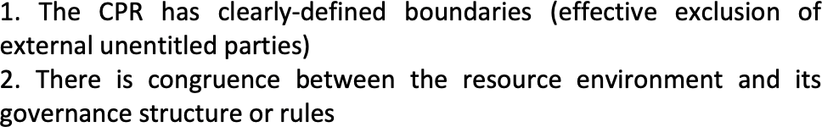
Design-principles for institutions managing common-pool resources (i.e., common goods such as natural resources)
Ostrom (1990)

Slide 46
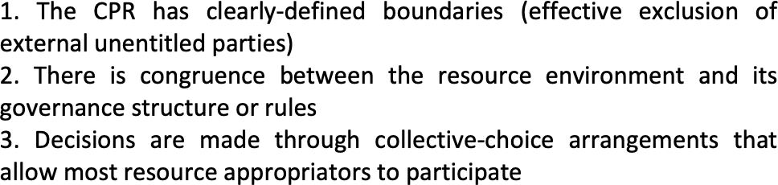
Design-principles for institutions managing common-pool resources (i.e., common goods such as natural resources)
Ostrom (1990)

Slide 47
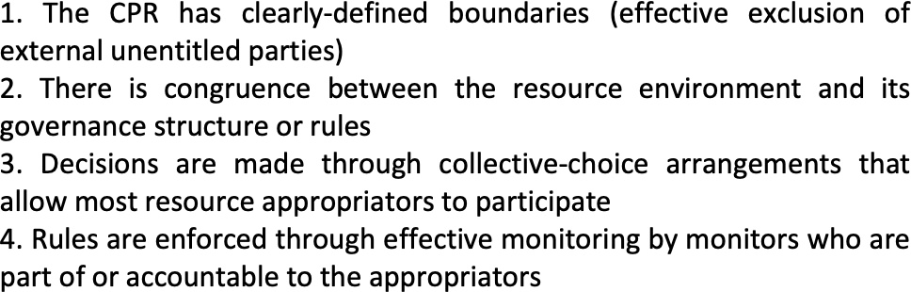
Design-principles for institutions managing common-pool resources (i.e., common goods such as natural resources)
Ostrom (1990)

Slide 48
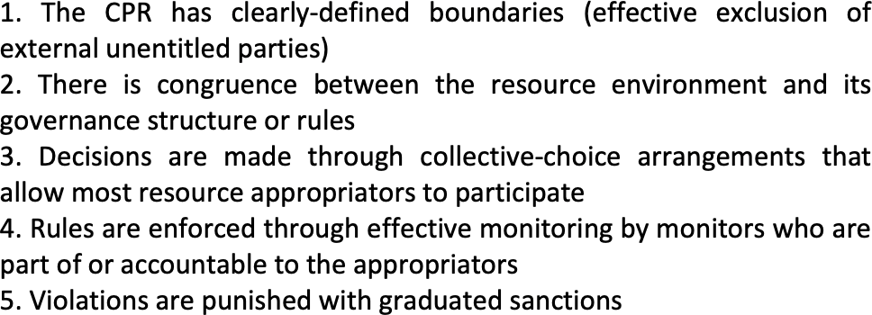
Design-principles for institutions managing common-pool resources (i.e., common goods such as natural resources)
Ostrom (1990)

Slide 49
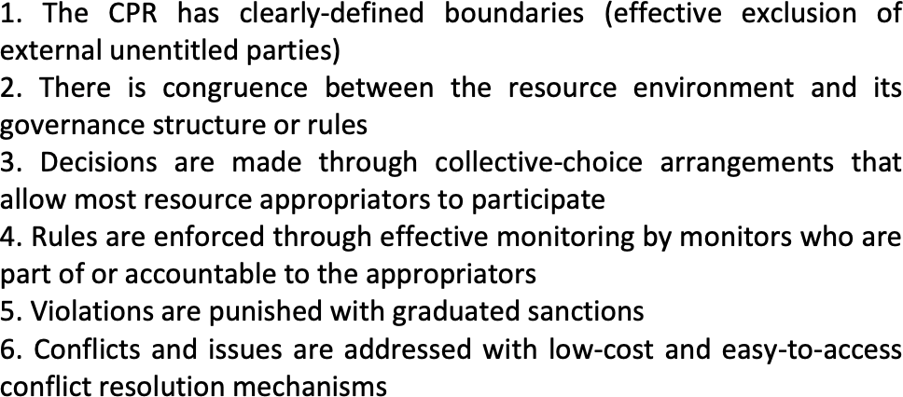
Design-principles for institutions managing common-pool resources (i.e., common goods such as natural resources)
Ostrom (1990)

Slide 50
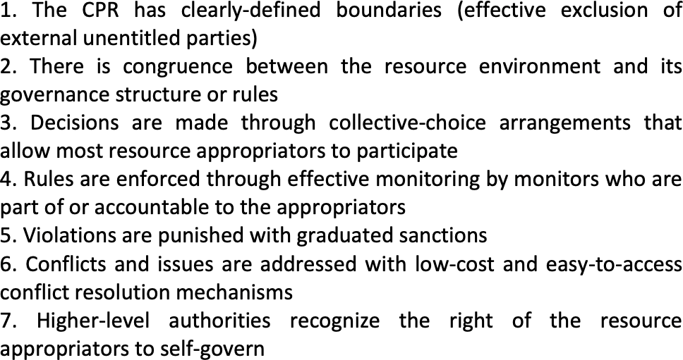
Design-principles for institutions managing common-pool resources (i.e., common goods such as natural resources)
Ostrom (1990)

Slide 51
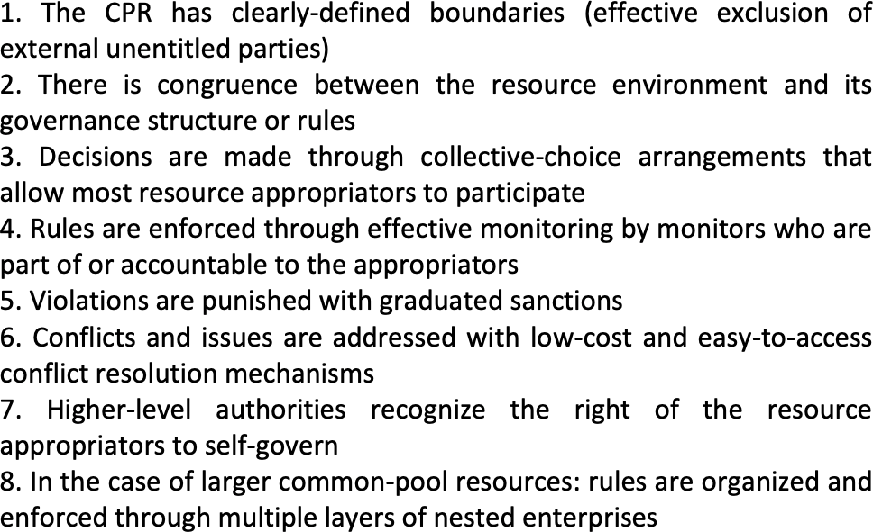
Design-principles for institutions managing common-pool resources (i.e., common goods such as natural resources)
Ostrom (1990)

Slide 52
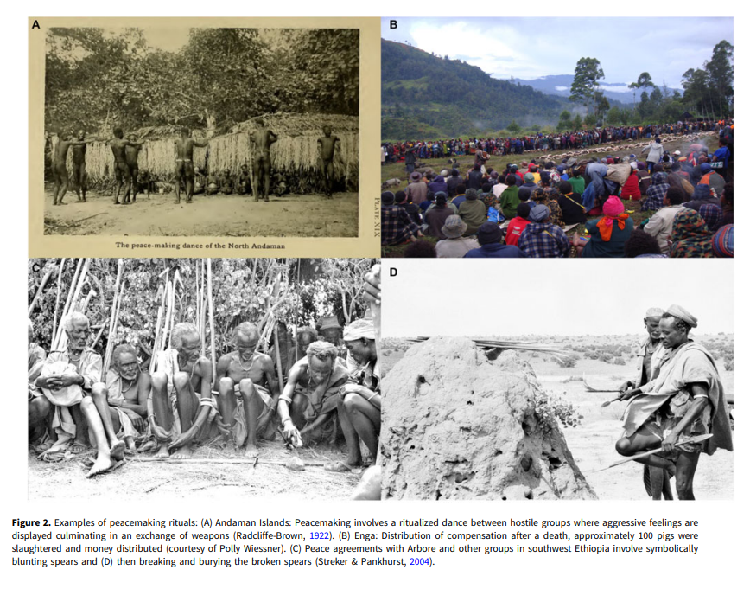
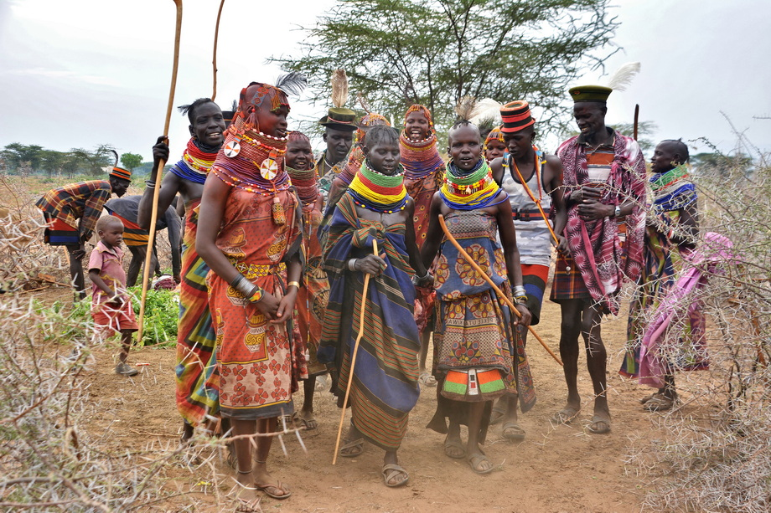
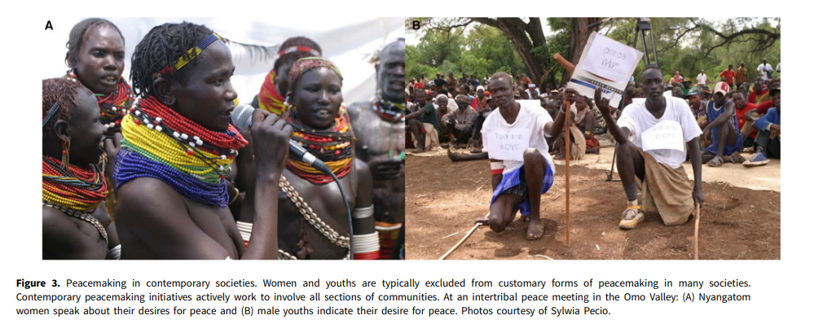
Age set systems in East African pastoralists
Lienard, P. (2014). Beyond kin: cooperation in a tribal society. Reward and punishment in social dilemmas, 214-234.
Glowacki, L. (2024). The evolution of peace. Behavioral and brain sciences, 47, e1.

Slide 53
Option 3: Saving RCT from itself. The case of behavioral econ

